Slide 1
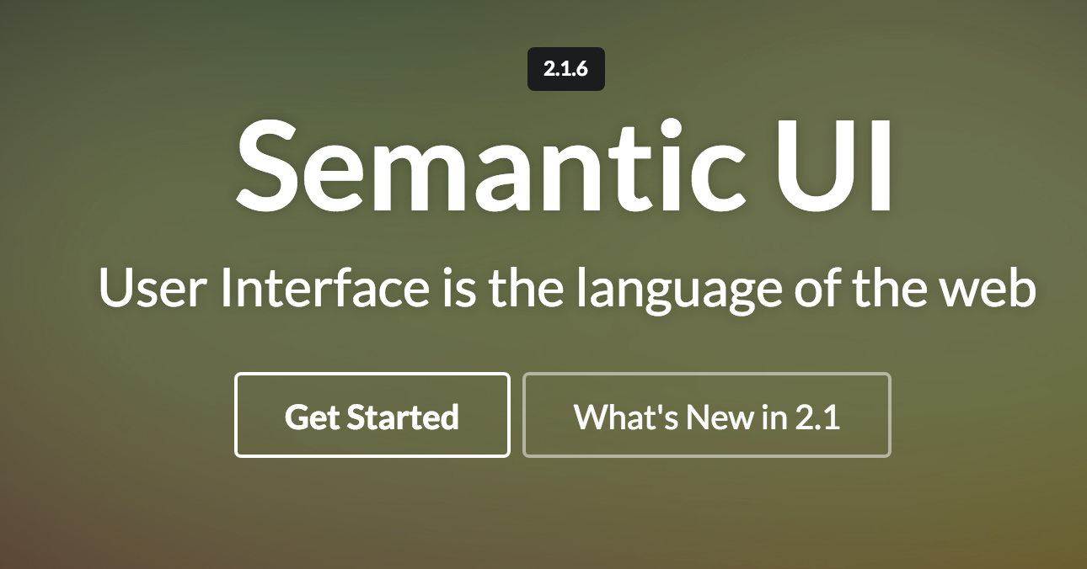
Semantic UI
Getting Started, Containers & Segments

Slide 2
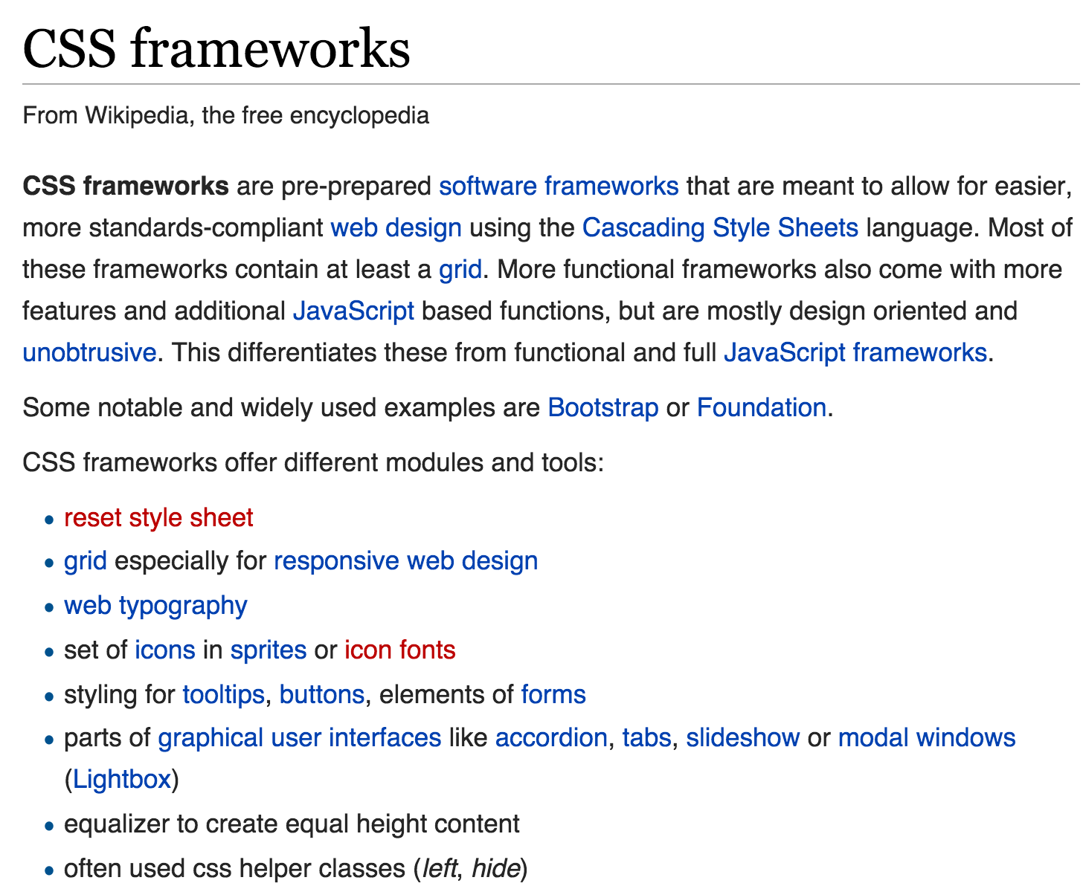


Slide 3
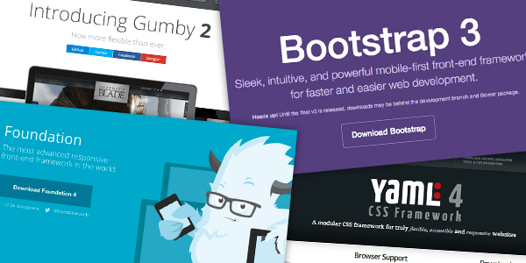
What is a CSS Framework?
“framework is defined as a package made up of a structure of files and folders of standardized code (HTML, CSS, JS etc.) which can be used to support the development of websites, as a basis to start building a site.”
“The aim of frameworks is to provide a common structure so that developers don’t have to redo it from scratch and can reuse the code provided"
http://www.awwwards.com/what-are-frameworks-22-best-responsive-css-frameworks-for-web-design.html

Slide 4
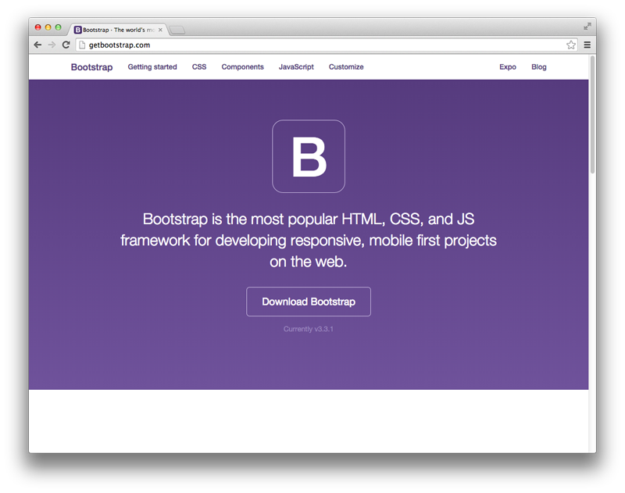

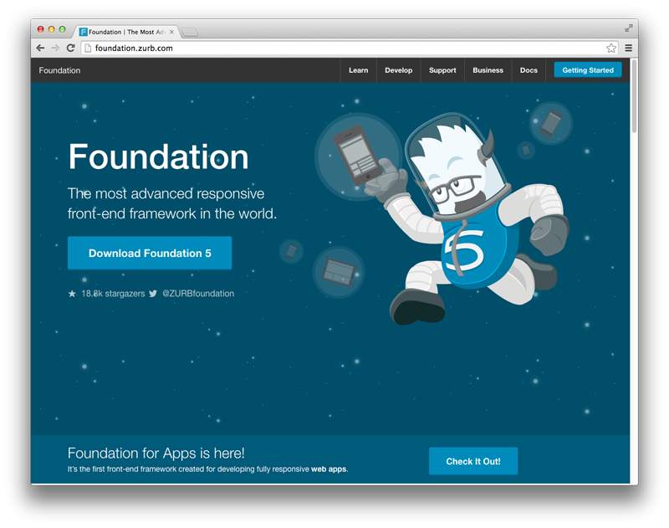
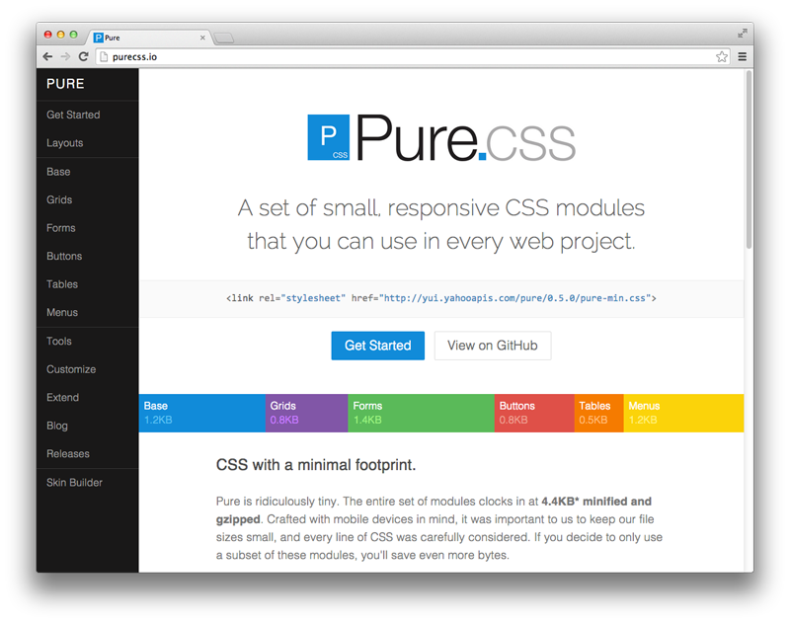
Popular Frameworks
http://www.sitepoint.com/5-most-popular-frontend-frameworks-compared/

Slide 5
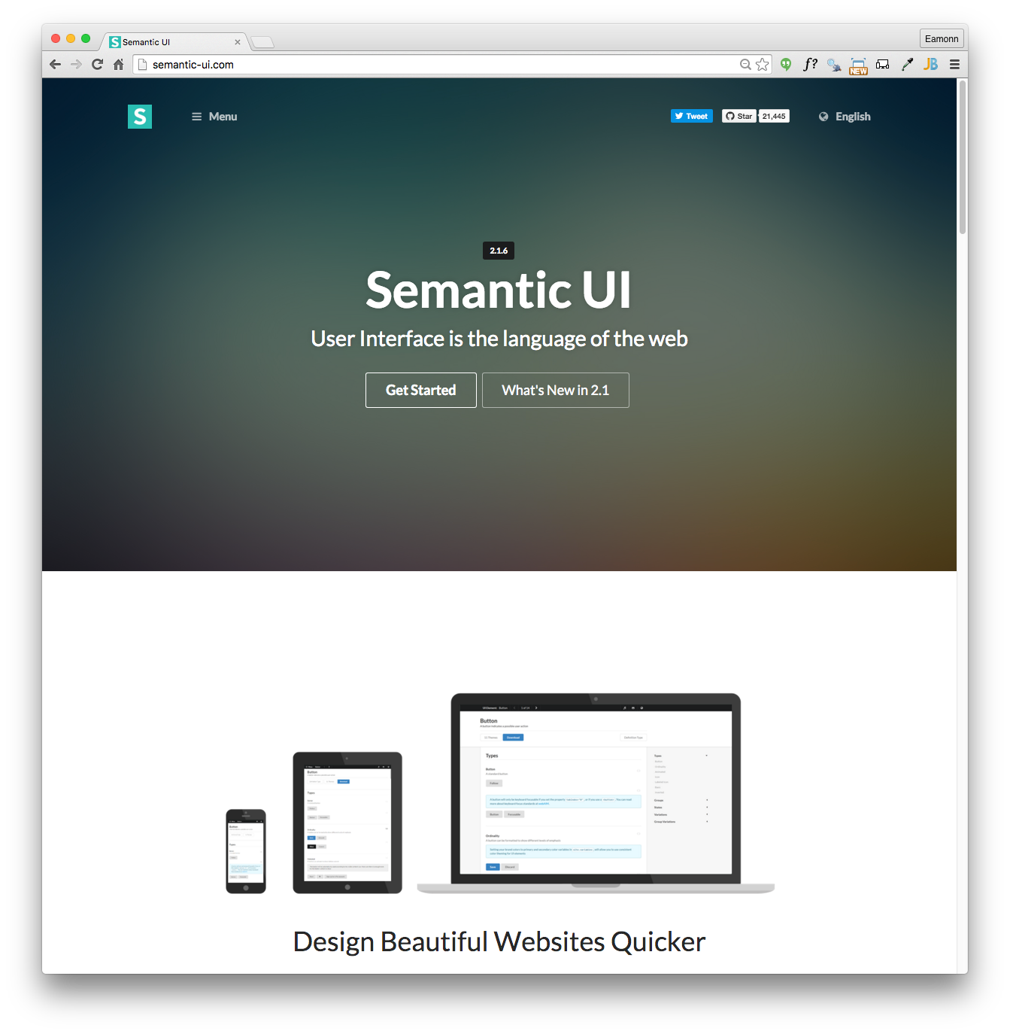

Slide 6
Semantic UI Starter
class =“ui container”
class =“ui segment”
class=“ui header”
class=“ui image”
class =“ui grid”
class “ui row”
class=“ui column”
Semantic css defines a large number of classes
Your elements take on Semantic-UI styles by adopting specific classes
All classes are preceded by “ui” to mark them as part of the framework

Slide 7
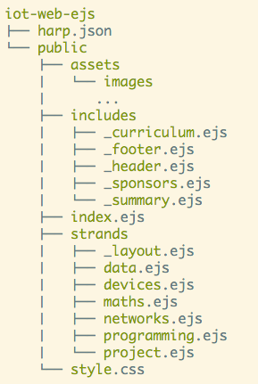
Project Structure
harp.son
public
assets folder
includes folder
other content folder(s)
index.ejs
style.css

Slide 8
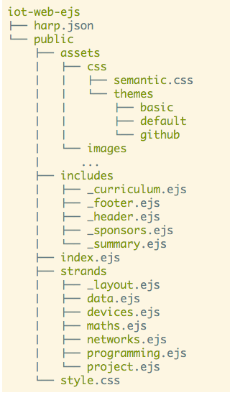
Incorporating Semantic-UI into the project
Download the semantic-ui archive
unzip and copy to the assets folder - inside a css folder
The semantic-ui archive is provided in the lab
(dont try to build it from the semantic-ui instructions)

Slide 9
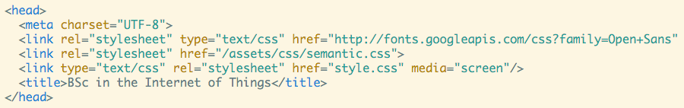
First Steps…
Link to the semantic.css stylesheet we have just included.
This makes most of the Semantic-UI components available to your project

Slide 10
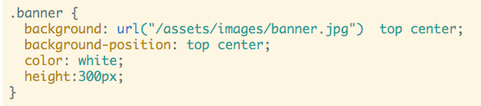
First Steps - remove existing stylesheet
Delete almost all CSS rules we have built up in the page so far
Leave just the ‘banner’ rule:

Slide 11

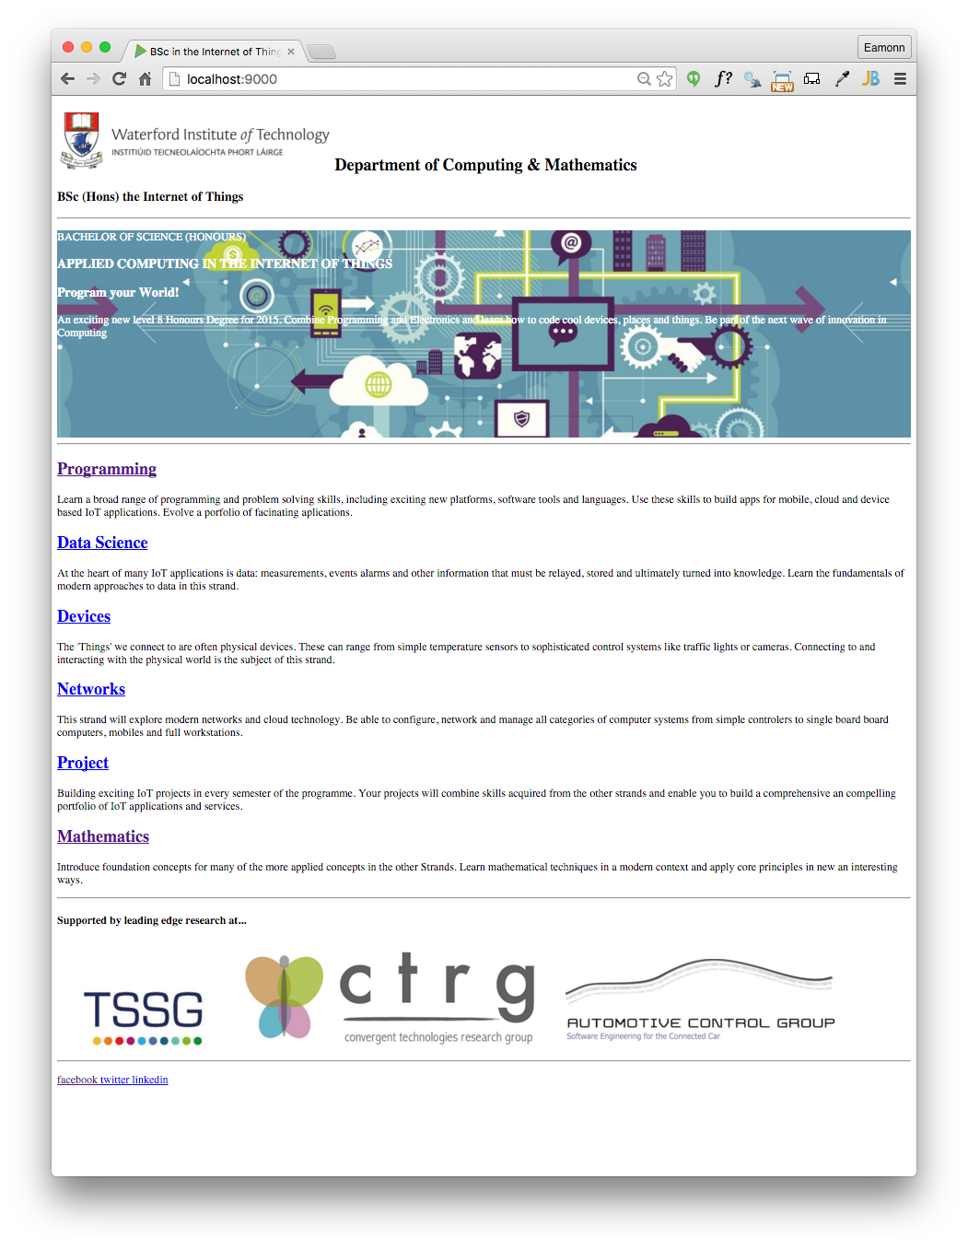

Slide 12
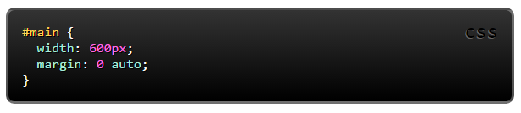
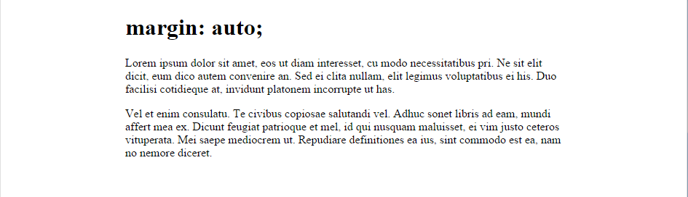
margin: auto;
Setting the width of a block-level element will stop it stretching out to the edges left and right. Then set the margin to auto left and right. This horizontally centres that element within its container.

Slide 13
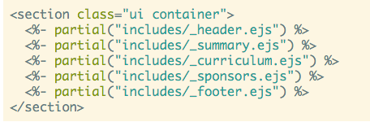


ui container
index.ejs
Replaces the need for “margin:auto” if we are using Semantic-UI

Slide 14
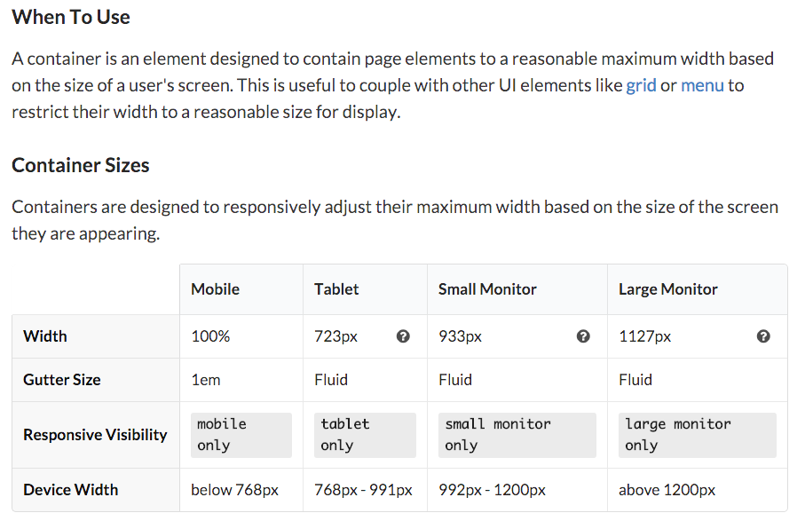
Containers
http://semantic-ui.com/elements/container.html

Slide 15
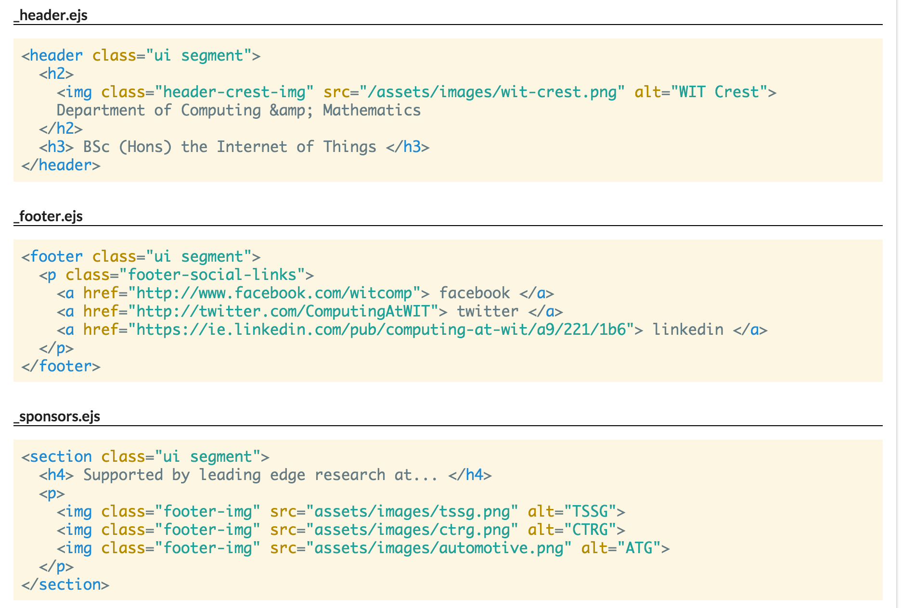
ui segment
Use to group related content
remove all of the ids and classes currently all files.
Give the enclosing articles/sections the class
class="ui segment":

Slide 16
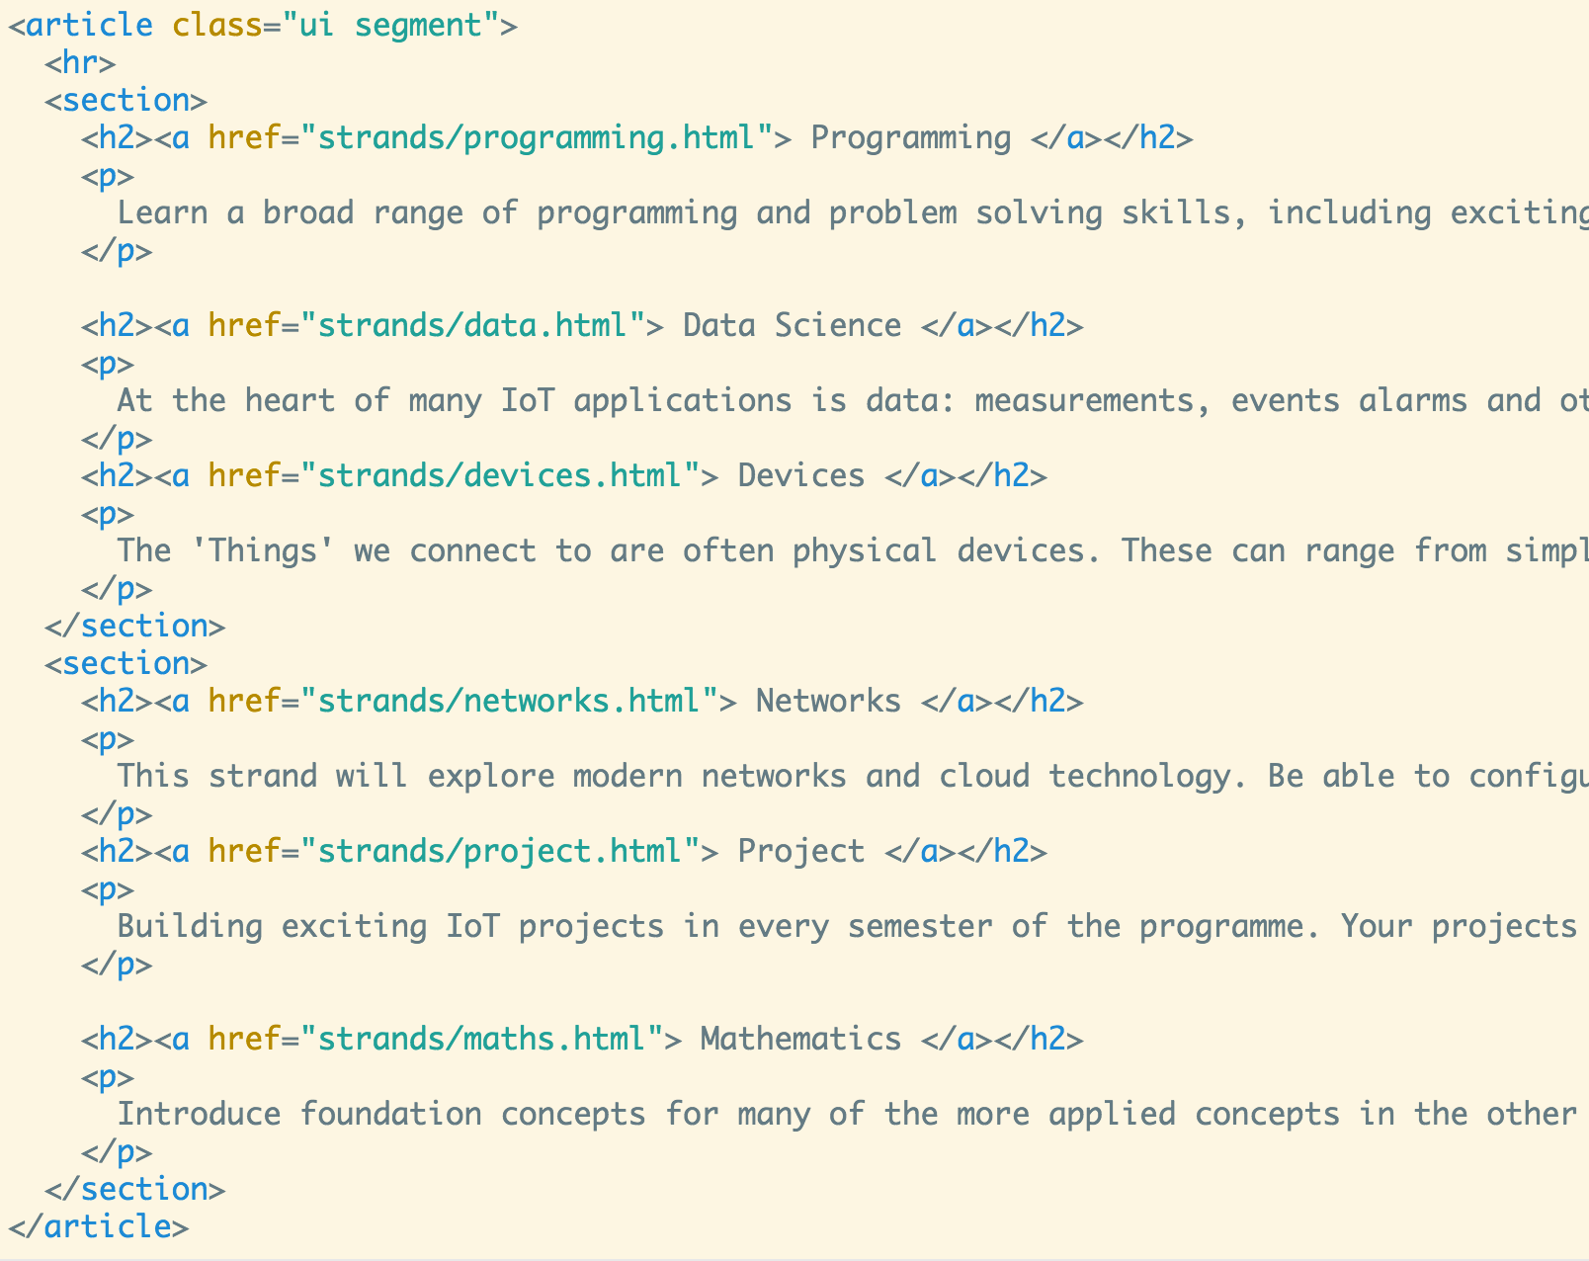
ui segment
curriculum.ejs

Slide 17

Segments
Introduces extra padding + a light border around the sections.

Slide 18
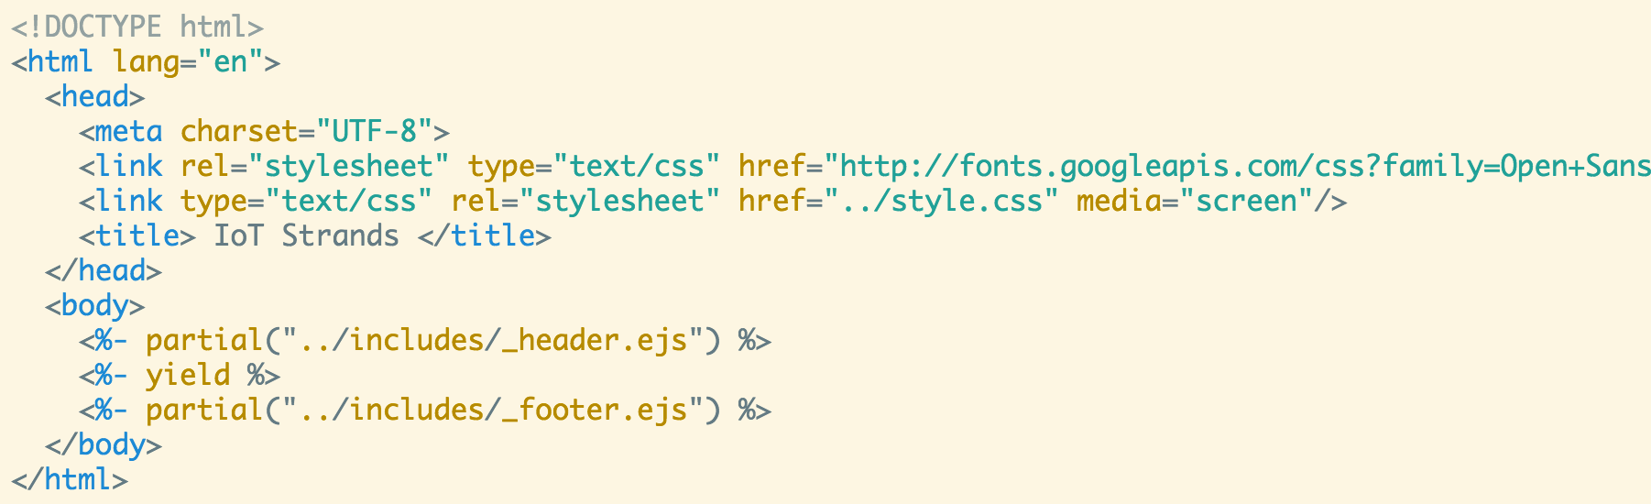
Modifying _layout.ejs
_layout defines the structure of all pages in the strands folder
Any change here effects all of the strand pages

Slide 19
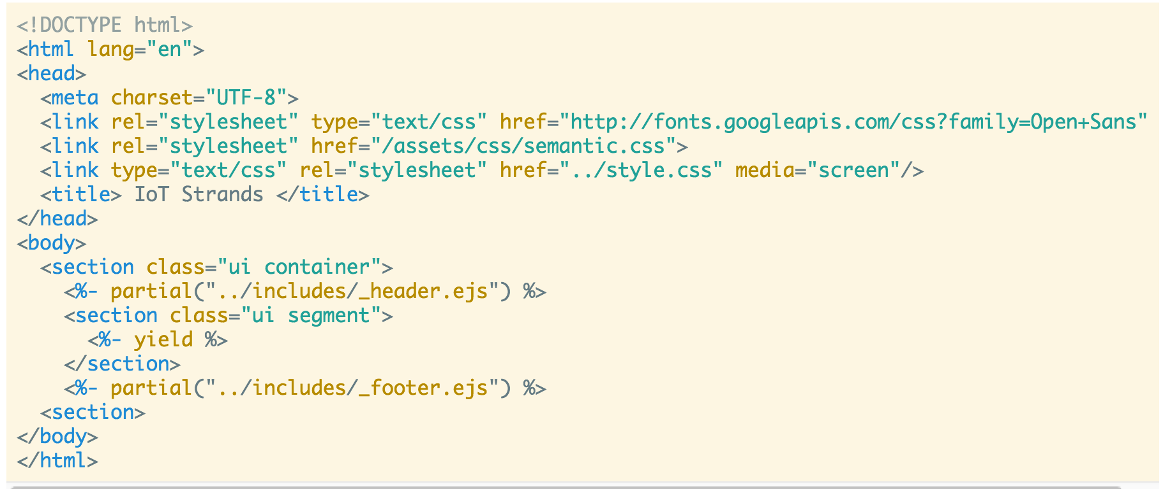
Modifying _layout.ejs
Introdude container + segment

Slide 20
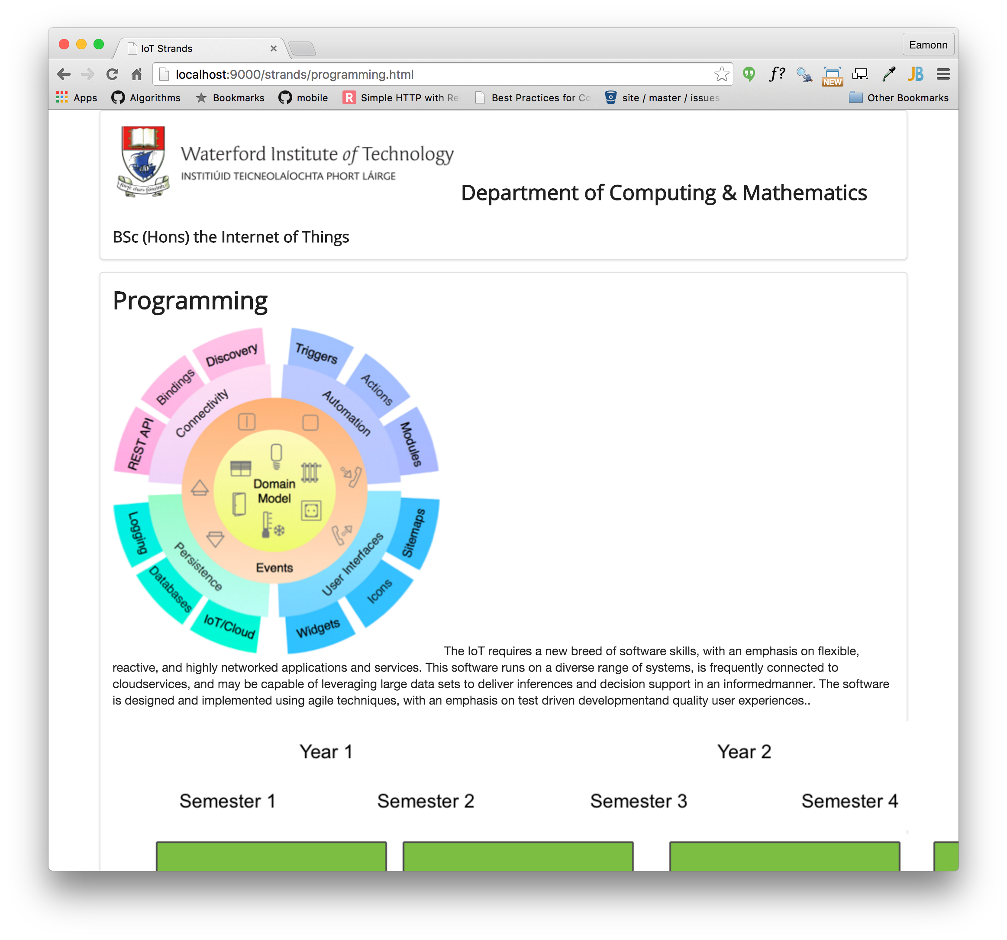

Slide 21
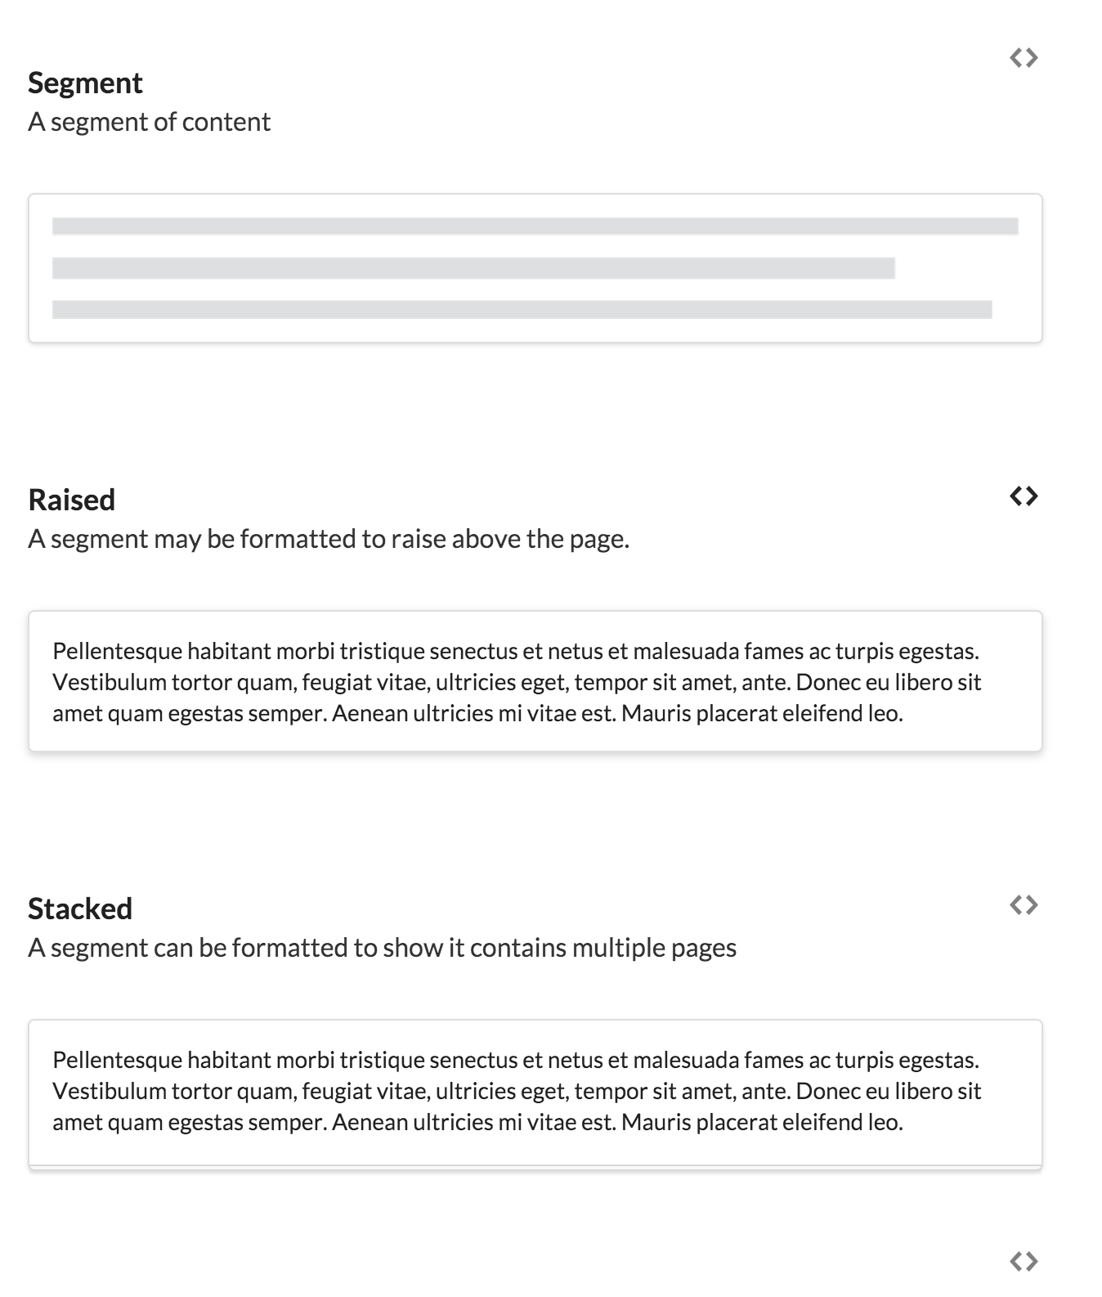
Segment Types

Slide 22
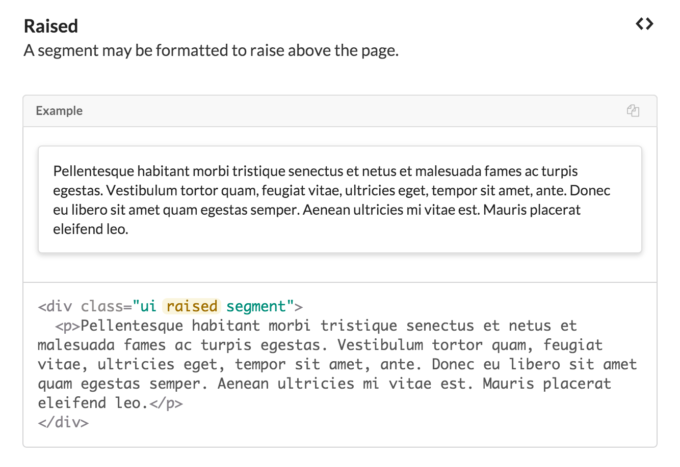
Eg: Raised Segments
This button reveals source

